Slide 1
Galway Buy & Sell
Professional I.T. Skills Project
By Raja and Waheed

Slide 2
Why We Made This Website
People all the Time Searching/Selling stuff online.
Easy to use and maintain.
very basic technology used to build.

Slide 3
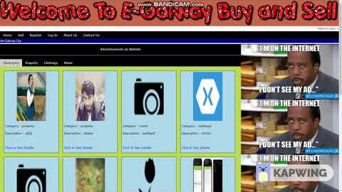
Galway Buy Sell

Slide 4
Technology Used to Build:
H.T.M.L
MySQL
P.H.P.
C.S.S.

Slide 5
Problems encountered
Little Effort Needed to Make it responsive without using any framework.
P.H.P. was new had to get acquainted.
P.H.P. had H.T.M.L. tags integrated, hence, little confusing, who’ll do what???

Slide 6
Conclusion
Should have used Framework for ease of development and maintenance.
Multiple images upload function found in new P.H.P. and will be added in future release.
Recommended using angular, Xamarin or any other similar frameworks.

Slide 7
Any Questions ?

